Slide 1
Developer Framework H2 2010

Slide 2
Overview
R
  Background and relation to DF
  A collection library for R
  Demo app ideas
  Pros and cons
RightGrid
  Basics programming model
  Implementing a collection library for R on RightGrid
  Pros and cons
DF tasks for H2
  Research items
  Contracting plans
  Deployment considerations
  Timelines
Stage 1 plan: to build a collection library for R on RightGrid

Slide 3
R Background
R
  Open source
  Extensible via packages
  Simple, effective, & well-recognized for statistical analysis
  Target uses are mostly not sophisticated programmers
RHIPE
  R interface to Hadoop MapReduce
  Not applicable to DF
RacheBase
  R interface to HBase
  Applicable to DF, especially some API and design choices

Slide 4
A Collection Library for R
SEN Developer Framework
Collection
Relational
Database
Key-Value
Pair
POSIX
Publish
Subscribe
User/Auth
Scheduled
Tasks
Collection primitives
  Map, reduce, filter, member test, pack, select, permute, …
Key-value pair
  Reuse ideas from RacheBase
POSIX
  Provided by R
Relational database
  Provided by existing packages: DBI, RODBC, RMySQL, RSQLite, ROracle, RPostgreSQL, etc

Slide 5
Demo Apps
Enablers related to the service of augmented reality
  Landmark recognition
    Comparing one image against landmark indices
    Each comparison is a series of matrix manipulation
  Knowledge base
    Searching multiple knowledge base in parallel?
  Social networking
    Manipulation of friends data as a whole
  Maps & directions (TBD)
Statistical apps
  Miyake-san’s work (TBD)
  Iterative computation (TBD)

Slide 6
Pros & Cons
Pros
  The “collection” idea is straightforwardly applicable to the main data types in R (vectors & lists)
  R already has some support on importing data into such collections (connection to DB and Files already exist)
  Reuse ideas from RacheBase to support key-value pairs
  Deployment is straightforward
Cons
  Domain limitation
  Some aspects of DF are not applicable

Slide 7
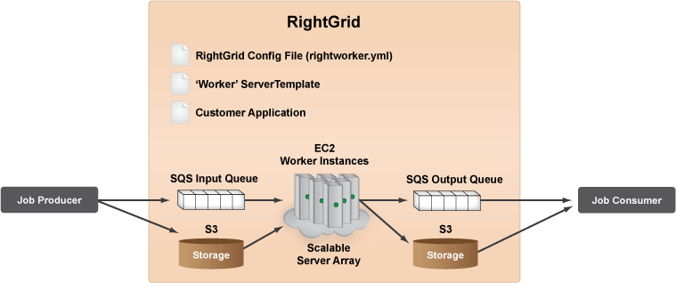
RightGrid Basics
We need to define the following for each collection primitive
  Config file, job producer, job consumer, worker
RightGrid calls platform services in the above fixed pattern

Slide 8
Implementing Collection on RightGrid
Map
  Job producer creates tasks based on a partition of the collection
  Job producer puts tasks in the input queue
  Each worker applies the given function to elements of a partition
  Job consumer checks the output queue for completed tasks
Reduce
  Job producer creates tasks based on a partition of the collection and a predetermined merging order
  Job producer puts tasks in the input queue
  Worker processes the merging of data based on their assignment
  Job consumer checks the output queue for task completion
Handling of other primitives are conceivable

Slide 9
Pros & Cons
Pros
  Simple and effective architecture/model
  Industrial strength platform and support
Cons
  Dependency on RightGrid may raise deployment issues
  Dependency on RightGrid may limit design space for other DF features/tools

Slide 10
DF Research in H2
Platform services
  Use RightGrid
  Interaction with “network storage” is no longer straightforward
Developer framework
  Using key-value pair in R (reuse ideas from RacheBase)
  Implementation of collection primitives (contracting)
  Research other support for agile development (e.g., conventions)
Service enablers & application/service development interface
  Design of the service enabler infrastructure
  Implementation of various service enablers, such as image comparison, contents sharing, maps and directions, etc (contracting)
Service building
  Development of the service logic should be straightforward (depends on the service enabler infrastructure)
  Some additional client-side work is require for a polished demo (contracting)

Slide 11
DF Contracting
Implementation of key-value pairs and collection primitives (6 man-months)
  Ready to go
  Requires knowledge of R & RightGrid
Implementation of service enablers (6 man-months)
  Pending on infrastructure design and collection implementation
  Requirements are on the domain of the enablers (e.g., statistical analysis, image processing), rather than on programming skills
Implementation of demo service (6 man-months)
  Pending on infrastructure design and collection implementation
  Requires background on client-side application building (server-side logic should be straightforward)

Slide 12
Deployment Considerations
Stage 1: to build a collection package for R running on RightScale
  Issues for open sourcing
  Dependency on RightGrid
  Domain limitation
  Some DF features non-applicable
Stage 2: to build our own “RightGrid” to remove the dependency on RightScale
Stage 3: to apply the idea to other languages to remove domain limitation and open up design space for DF

Slide 13
Stage 1 Timelines
Topic | Q3 2010 | Q4 2010 | Q1 2011 | Q2 2011 | Q3 2011
Collection Library
Service Enablers
Service Demo
Primitive implementation
Datastore support
Other agility aspects
SE infrastructure
AR-related SE building
Analytics SE building
Service building (client side)
Service building (server side)
Research
Prototyping

